Slide 1

Lesson 0.5: Snap! Coordinate System
Microsoft Philanthropies TEALS Program
Introduction to Computer Science

Slide 2
Snap! Coordinate System
After this lesson, you will be able to...
Recall the Cartesian Coordinate system
Implement the coordinate system to position a sprite using Snap Coordinates

Slide 3
Today’s Plan
Do Now
Introduction to the Snap! Coordinate System
Integrate Coordinate Concept to Snap!
Lab Activity
Debrief and wrap- up
Notes:
5 minutes | Do Now
10 minutes | Introduce Snap! Coordinate System
15 minutes | Integrate Coordinate Concept to Snap!
15 minutes | Lab Activity
5 minutes | Debrief and wrap-up

Slide 4

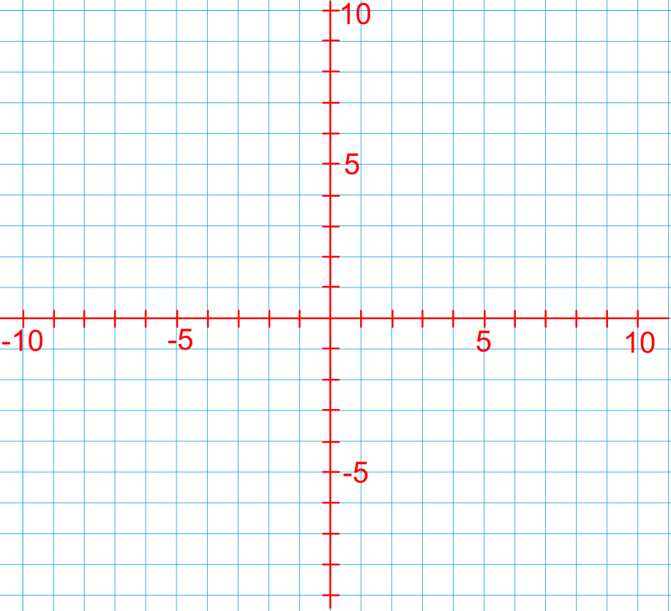
Do Now 0.5: Draw the Coordinate System
In your Notebook, Draw this image to the best of your ability
In your Notebook, Draw this image to the best of your ability

Slide 5

Introduce the coordinate plane
Notes:
Tell students that today they will explore SNAP and use it to create a "self-portrait" program.
Emphasize that the goal of today's lesson is not for students to develop a deep understanding of any of the features in SNAP. Later lessons will teach them everything they need to know. For now, they should just explore, figure out what they can, and put it to use however they see fit.
Spend just a couple minutes demonstrating how to open SNAP, create sprites and scripts, and run programs.

Slide 6

Lab 0.4: Getting to Know You
Goal: Explore SNAP and create a simple "self-portrait" program to introduce yourself
Lab instructions:
Take a few minutes to read the lab handout
Notes:
Show students the lab handout and read through the instructions.
Point out the places to write answers to the written questions in parts 1.2 and 1.3.
Draw special attention to the list of requirements for the self-portrait program in part 1.4.
This is an excellent opportunity to tell students that all labs in this course will look similar to this, and that they should get used to reading instructions carefully.
Sample walkthrough of lab 0.4: https://www.youtube.com/watch?v=7fncD7NH7g8 (Credit: William Masse)

Slide 7

Debrief
What is ONE feature that you discovered in SNAP?
What did you enjoy working with SNAP?
What did you not like?
Notes:
Ask each student to identify and describe one feature they discovered in SNAP. Keep a running list on the whiteboard or projector.
If the students build a pretty comprehensive list, you can use this as a chance to go over a brief roadmap for the course.
Ask students what they enjoyed about working with SNAP and what they disliked

